Slide 1
Efficient Algorithms
Ekkapot Charoenwanit
Electrical and Computer Engineering (ECE)
TGGS
KMUTNB

Slide 2
Lecture 4: Data Structures (Part II)
Hashing

Slide 3
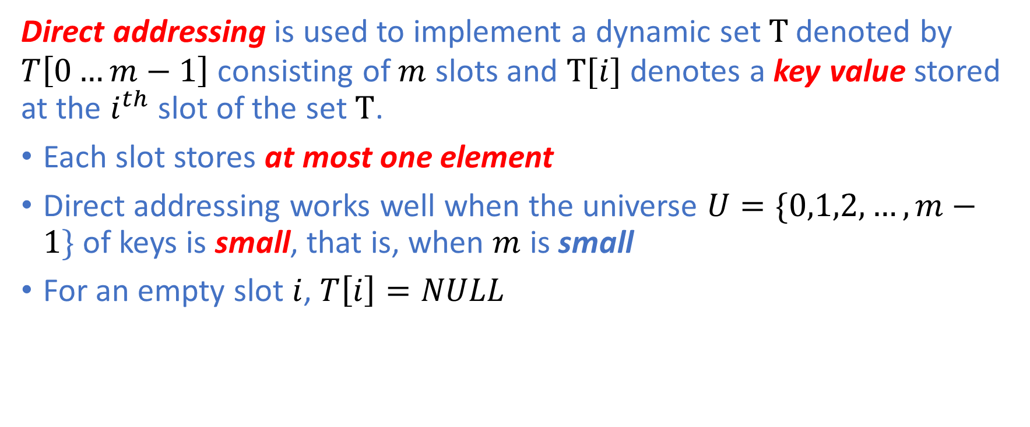
Direct-Addressing
Direct addressing is used to implement a dynamic set $T$ denoted by $T\left[0…m−1\right]$ consisting of $m$ slots and $T[i]$ denotes a key value stored at the $i^{th}$ slot of the set $T$.
Each slot stores at most one element
Direct addressing works well when the universe $U=\{0,1,2,…,m−1\}$ of keys is small, that is, when $m$ is small
For an empty slot $i$, $T\left[i\right]=NULL$

Slide 4
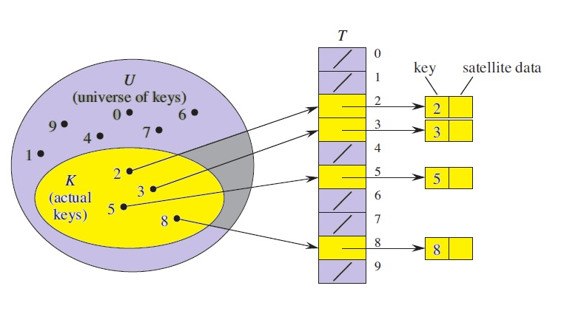
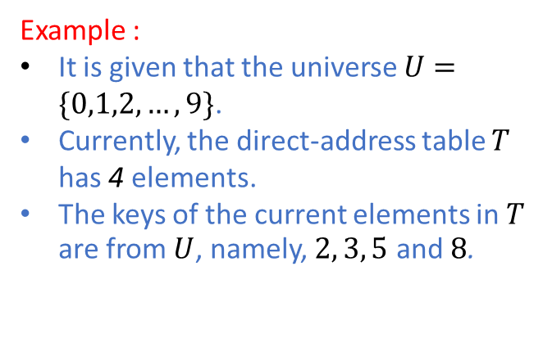
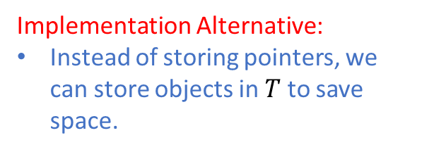
Direct-Address Table
Implementation:
Each slot stores a pointer to the actual object.
Objects consist of two parts: key and data.
Implementation Alternative:
Instead of storing pointers, we can store objects in $T$to save space.
Example :
It is given that the universe $U=\{0,1,2,…,9\}$.
Currently, the direct-address table $T$ has 4 elements.
The keys of the current elements in $T$ are from $U$, namely, $2, 3, 5$ and $8$.
Illustration from the CLRS book (Figure 11.1)

Slide 5



Basic Operations
All the three basic operations of the direct-address table are $O\left(1\right)$ operations.

Slide 6
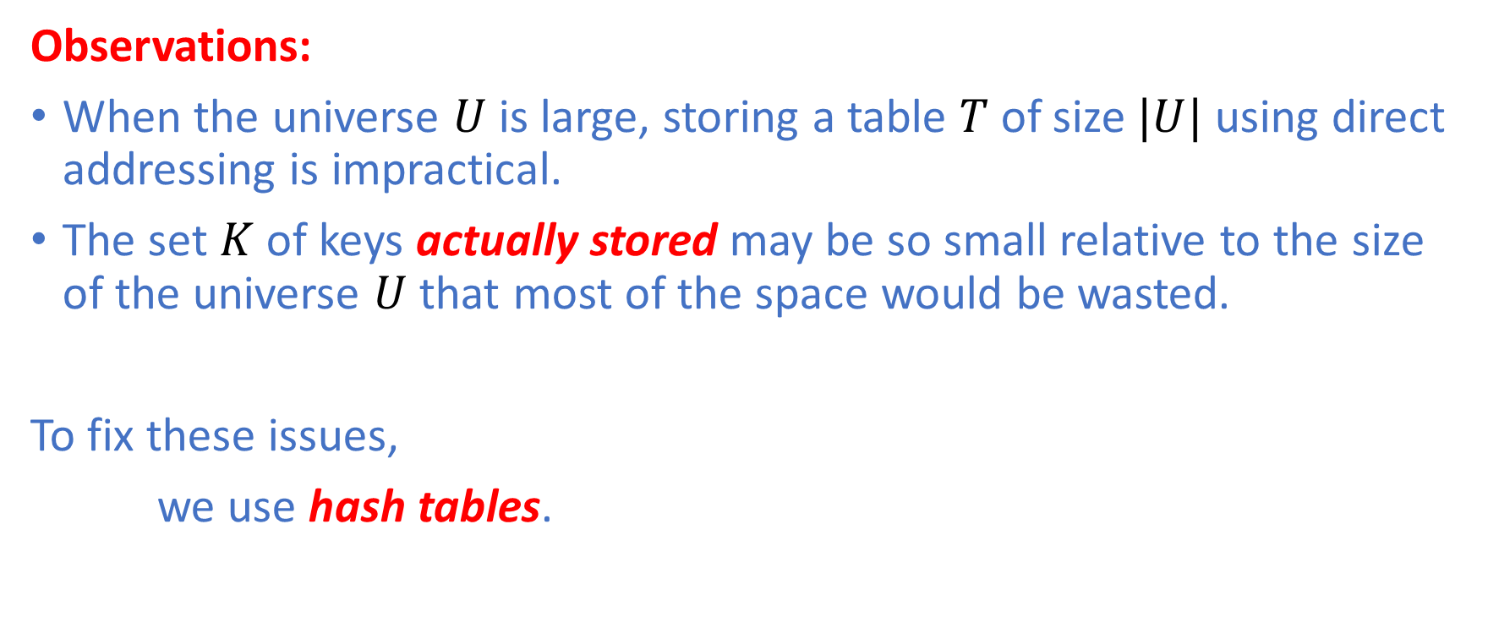
Downsides of Direct Addressing
Observations:
When the universe $U$ is large, storing a table $T$of size $|U|$ using direct addressing is impractical.
The set $K$ of keys actually stored may be so small relative to the size of the universe $U$ that most of the space would be wasted.
To fix these issues,
we use hash tables.

Slide 7
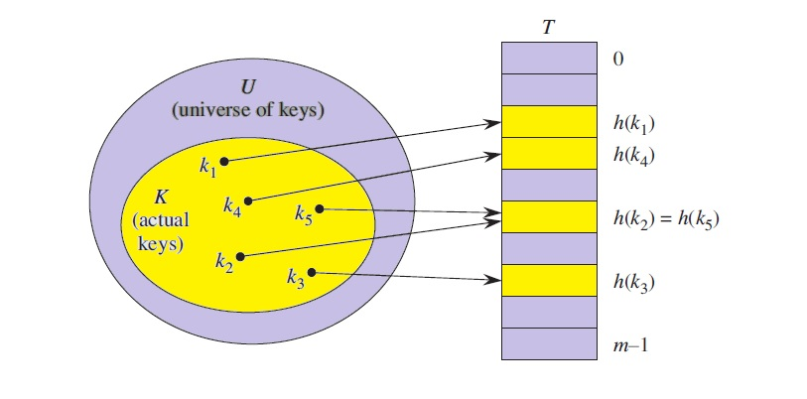
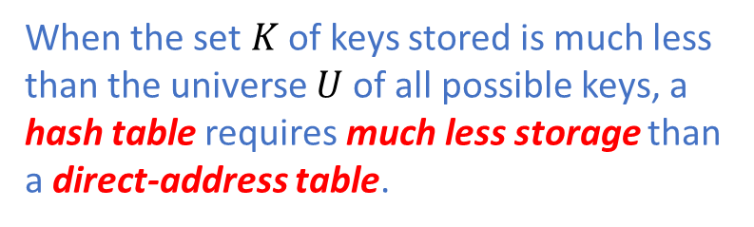
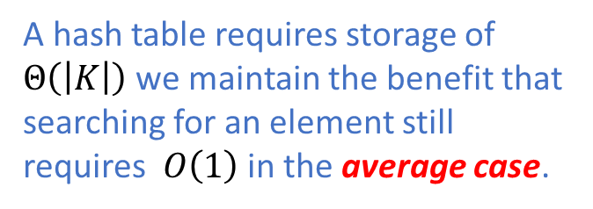
Hash Table
When the set $K$ of keys stored is much less than the universe $U$ of all possible keys, a hash table requires much less storage than a direct-address table.
A hash table requires storage of $Θ\left(\left|K\right|\right)$ we maintain the benefit that searching for an element still requires $O\left(1\right)$ in the average case.
Illustration from the CLRS book (Figure 11.2)

Slide 8
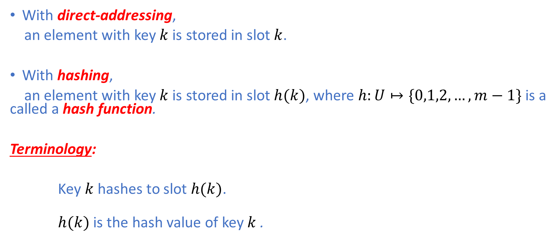
Hash Function
With direct-addressing,
an element with key $k$ is stored in slot $k$.
With hashing,
an element with key $k$ is stored in slot $h(k)$, where $h:U↦\{0,1,2,…,m−1\}$ is a called a hash function.
Terminology:
Key $k$ hashes to slot $h(k)$.
$h(k)$ is the hash value of key $k$.

Slide 9
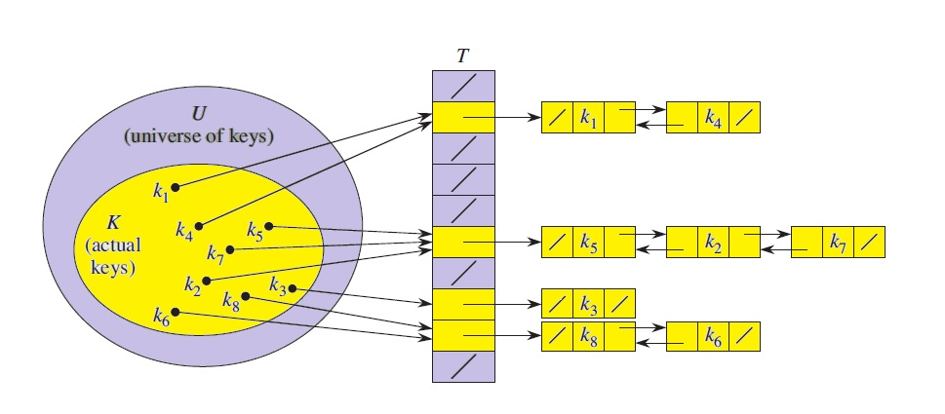
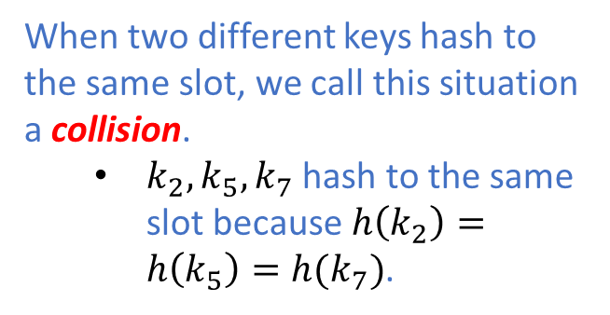
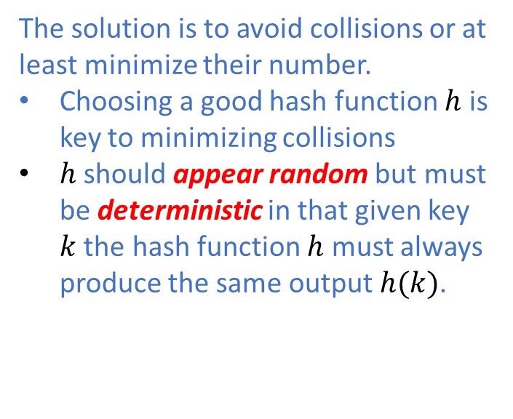
Hashing Collision
When two different keys hash to the same slot, we call this situation a collision.
$k_{2},k_{5},k_{7}$ hash to the same slot because $h\left(k_{2}\right)=h\left(k_{5}\right)=h(k_{7})$.
The solution is to avoid collisions or at least minimize their number.
Choosing a good hash function $h$ is key to minimizing collisions
$h$ should appear random but must be deterministic in that given key $k$ the hash function $h$ must always produce the same output $h(k)$.
Illustration from the CLRS book (Figure 11.3)

Slide 10
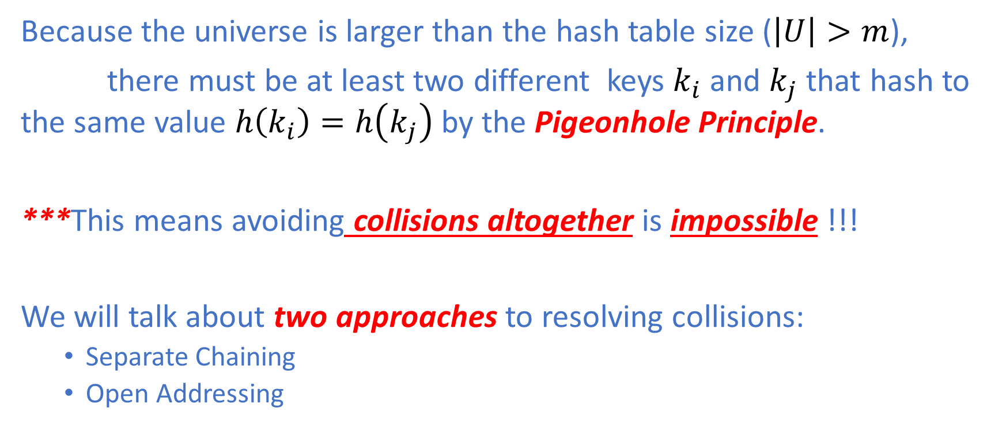
Collision Resolution
Because the universe is larger than the hash table size ($\left|U\right|>m$),
there must be at least two different keys $k_{i}$and $k_{j}$ that hash to the same value $h\left(k_{i}\right)=h\left(k_{j}\right)$ by the Pigeonhole Principle.
***This means avoiding collisions altogether is impossible !!!
We will talk about two approaches to resolving collisions:
Separate Chaining
Open Addressing

Slide 11

Separate Chaining
In separate chaining,
elements that hash to the same slot are placed into the same linked list
slot $j$ stores a pointer to the head f the linked list of all stored elements that hash to $j$
For an empty slot $j$, $T(j)=NULL$
Illustration from the CLRS book (Figure 11.3)

Slide 12

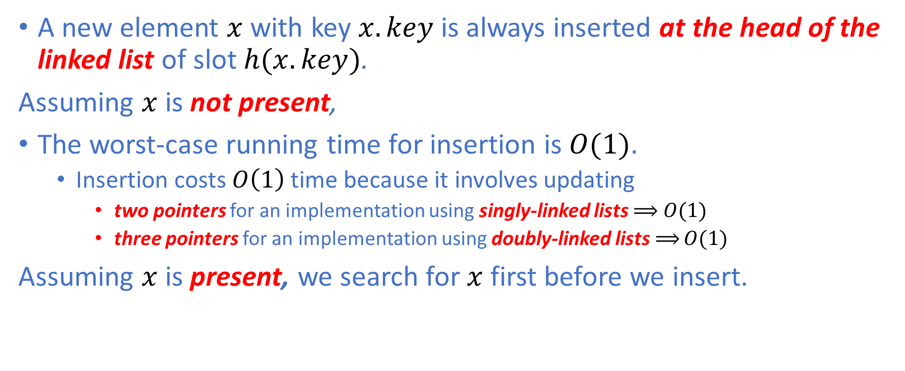
Basic Operation: Insert
A new element $x$ with key $x.key$ is always inserted at the head of the linked list of slot $h(x.key)$.
Assuming $x$ is not present,
The worst-case running time for insertion is $O(1)$.
Insertion costs $O\left(1\right)$ time because it involves updating
two pointers for an implementation using singly-linked lists $⟹$ $O(1)$
three pointers for an implementation using doubly-linked lists$⟹$ $O(1)$
Assuming $x$ is present, we search for $x$first before we insert.

Slide 13

Basic Operation: Search
The worst-case running time for search is proportional to the length of the list.
We will do analysis on the average cost of this operation in detail.

Slide 14


Basic Operation: Delete
The worst-case running time of deleting an element is $O(1)$
for an implementation using doubly-linked lists

Slide 15
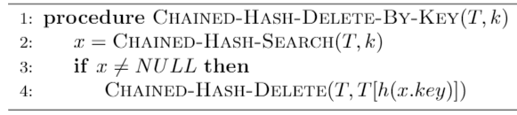

Basic Operation: Delete by Key
To delete an element $x$ by key $k$ , we can make use of the search and the delete operation previously discussed as follows:

Slide 16
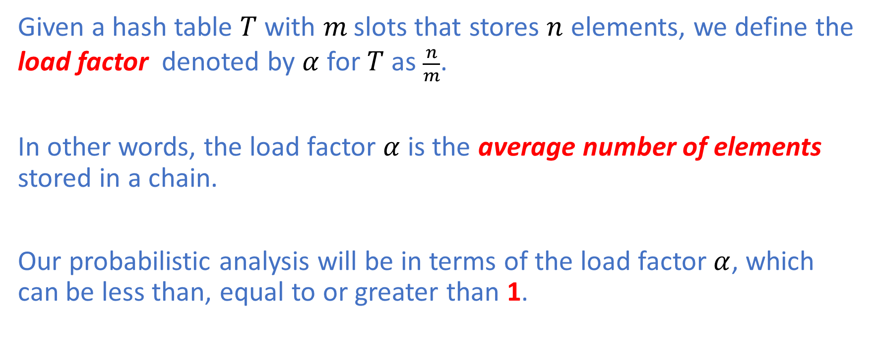
Load Factor
Given a hash table $T$ with $m$ slots that stores $n$ elements, we define the load factor denoted by $α$ for $T$ as $\frac{n}{m}$.
In other words, the load factor $α$ is the average number of elements stored in a chain.
Our probabilistic analysis will be in terms of the load factor $α$, which can be less than, equal to or greater than 1.

Slide 17
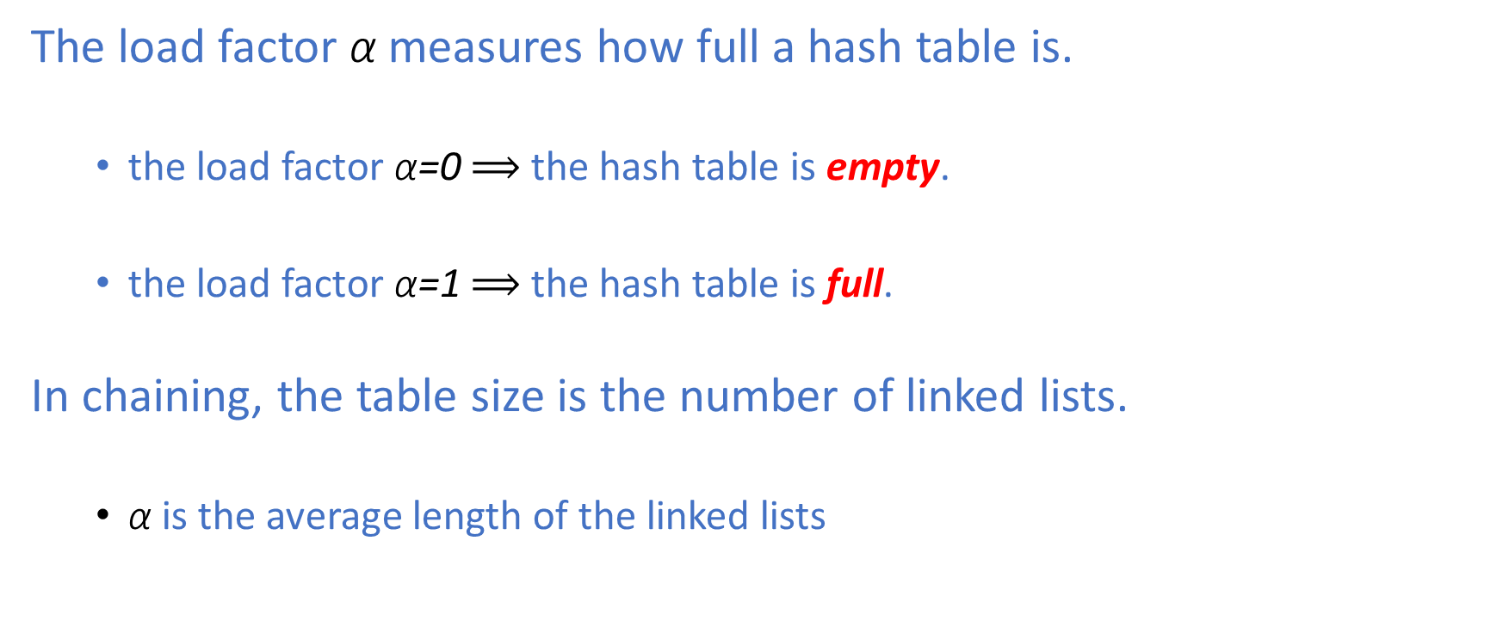
Load Factor
The load factor α measures how full a hash table is.
the load factor α=0 $⟹$ the hash table is empty.
the load factor α=1 $⟹$ the hash table is full.
In chaining, the table size is the number of linked lists.
α is the average length of the linked lists

Slide 18
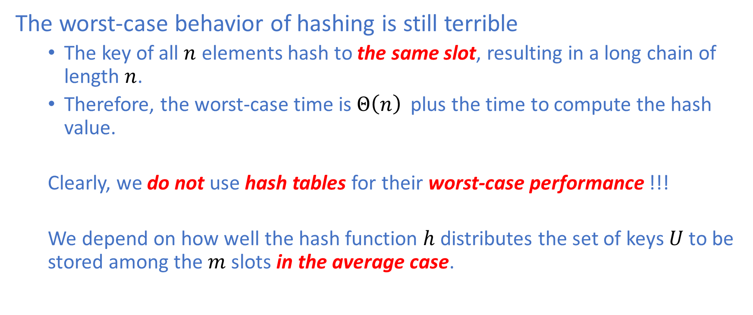
Average-Case Analysis
The worst-case behavior of hashing is still terrible
The key of all $n$ elements hash to the same slot, resulting in a long chain of length $n$.
Therefore, the worst-case time is $Θ\left(n\right)$ plus the time to compute the hash value.
Clearly, we do not use hash tables for their worst-case performance !!!
We depend on how well the hash function $h$distributes the set of keys $U$ to be stored among the $m$ slots in the average case.

Slide 19
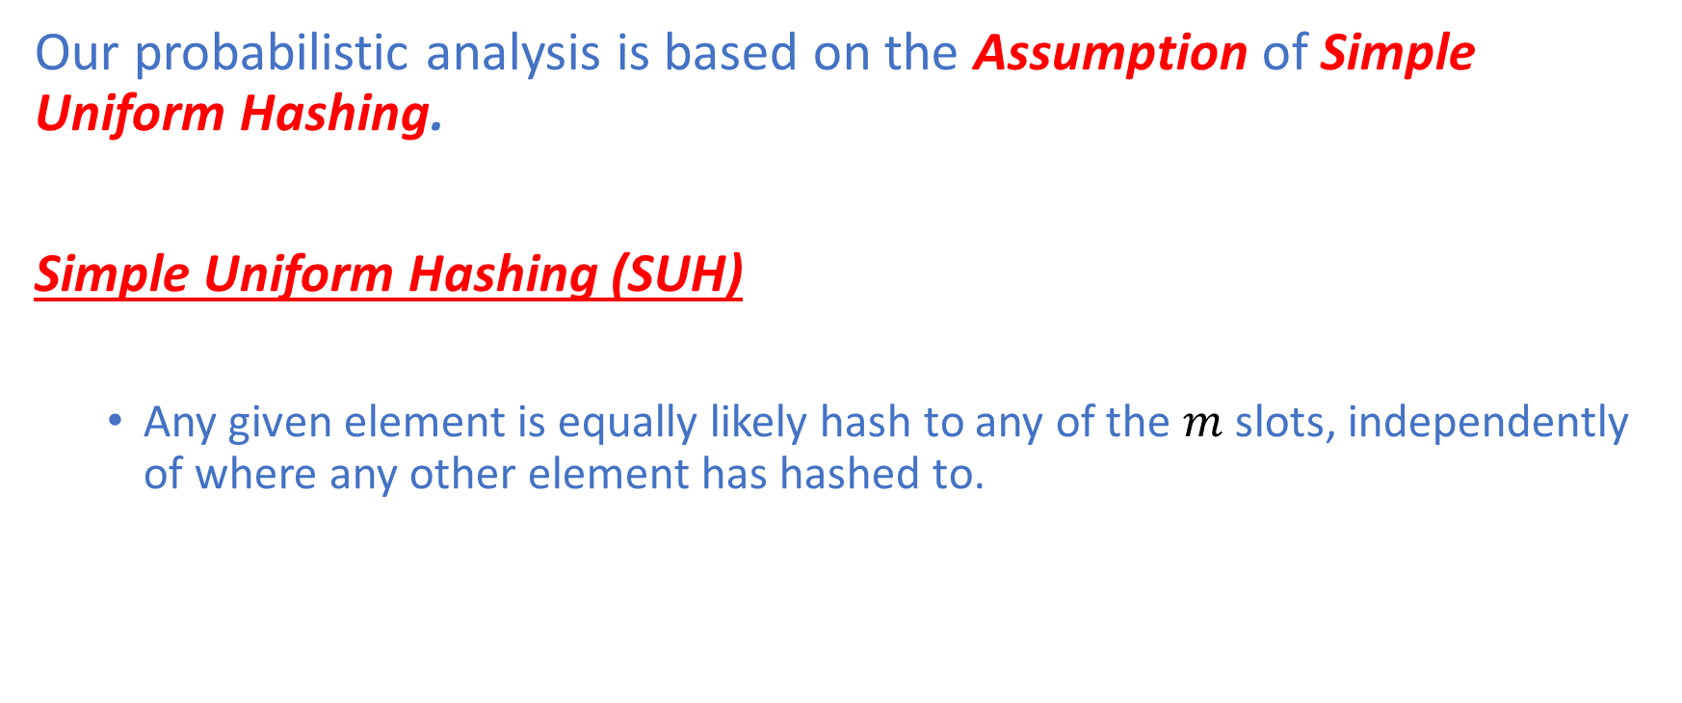
Simple Uniform Hashing
Our probabilistic analysis is based on the Assumption of Simple Uniform Hashing.
Simple Uniform Hashing (SUH)
Any given element is equally likely hash to any of the $m$ slots, independently of where any other element has hashed to.

Slide 20
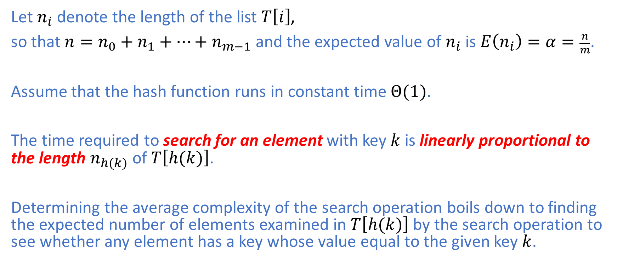
Simple Uniform Hashing
Let $n_{i}$ denote the length of the list $T\left[i\right]$,
so that ${n=n}_{0}+n_{1}+…+n_{m−1}$ and the expected value of $n_{i}$ is $E\left(n_{i}\right)=α=\frac{n}{m}$.
Assume that the hash function runs in constant time $Θ(1)$.
The time required to search for an element with key $k$ is linearly proportional to the length $n_{h(k)}$ of $T\left[h(k)\right]$.
Determining the average complexity of the search operation boils down to finding the expected number of elements examined in $T\left[h(k)\right]$ by the search operation to see whether any element has a key whose value equal to the given key $k$.

Slide 21
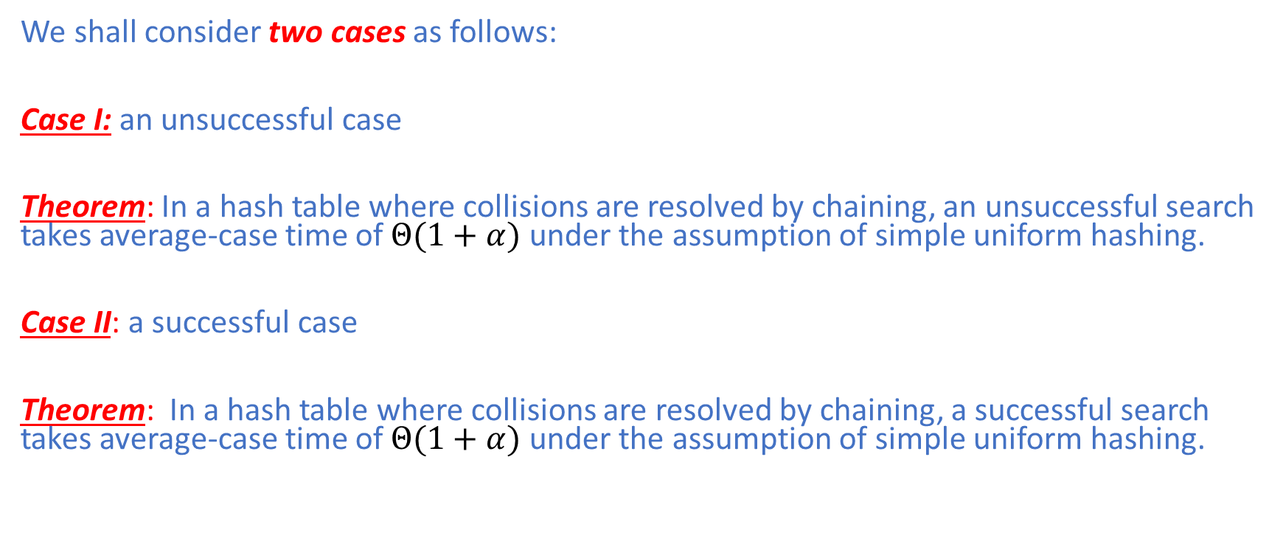
The average-case complexity of search
We shall consider two cases as follows:
Case I: an unsuccessful case
Theorem: In a hash table where collisions are resolved by chaining, an unsuccessful search takes average-case time of$Θ(1+α)$ under the assumption of simple uniform hashing.
Case II: a successful case
Theorem: In a hash table where collisions are resolved by chaining, a successful search takes average-case time of$Θ(1+α)$ under the assumption of simple uniform hashing.

Slide 22
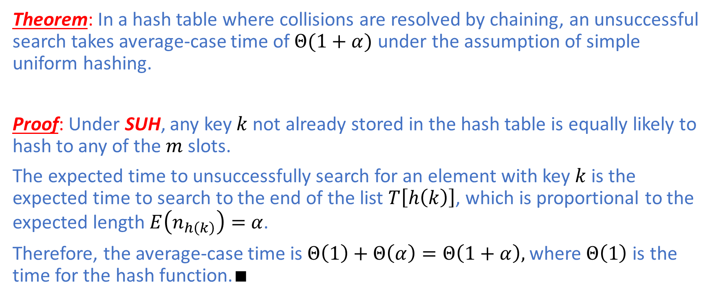
Unsuccessful Search
Theorem: In a hash table where collisions are resolved by chaining, an unsuccessful search takes average-case time of$Θ(1+α)$ under the assumption of simple uniform hashing.
Proof: Under SUH, any key $k$ not already stored in the hash table is equally likely to hash to any of the $m$ slots.
The expected time to unsuccessfully search for an element with key $k$ is the expected time to search to the end of the list $T\left[h\left(k\right)\right]$, which is proportional to the expected length $E\left(n_{h\left(k\right)}\right)=$ $α$.
Therefore, the average-case time is $Θ\left(1\right)+Θ\left(α\right)=Θ\left(1+α\right),$ where$Θ\left(1\right)$ is the time for the hash function.$∎$

Slide 23
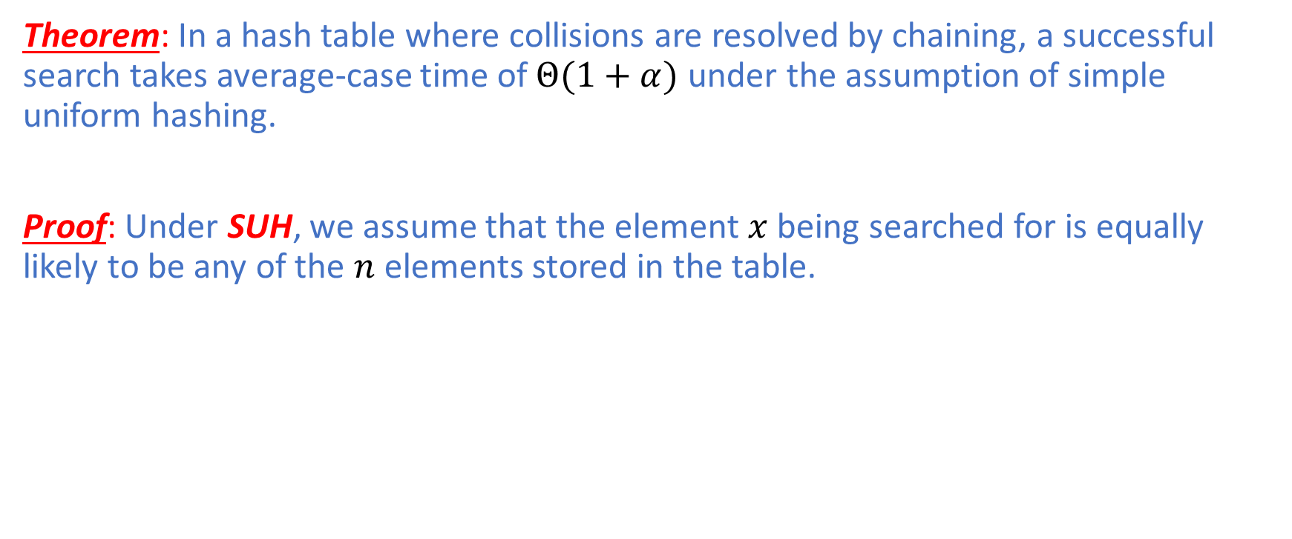
Successful Search
Theorem: In a hash table where collisions are resolved by chaining, a successful search takes average-case time of$Θ(1+α)$ under the assumption of simple uniform hashing.
Proof: Under SUH, we assume that the element $x$ being searched for is equally likely to be any of the $n$ elements stored in the table.

Slide 24
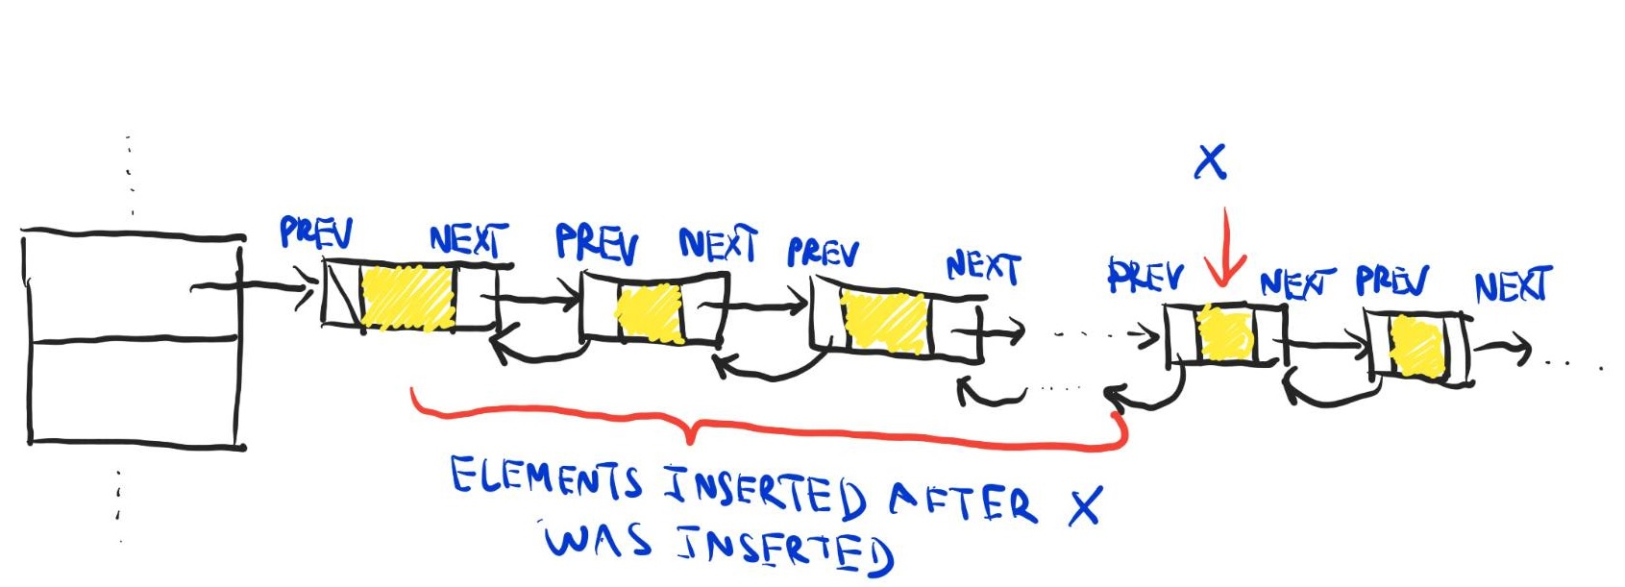

Successful Search
Key Observation I: The number of elements examined during a successful search for $x$ is one more than the number of elements that appear before $x$ in the chain.
Key Observation II: New elements are placed at the front of the chain $⟹$ elements before $x$ in the chain were all inserted after $x$ was inserted

Slide 25
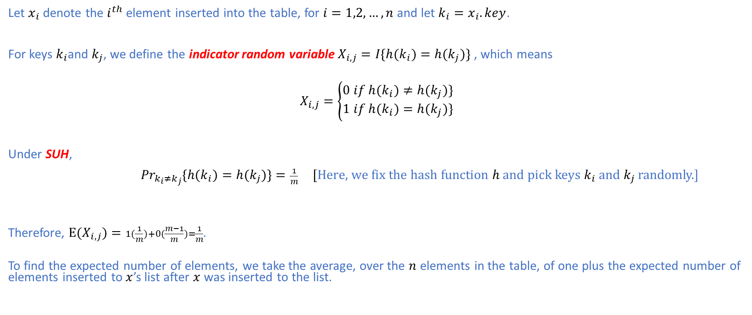
Successful Search
Let $x_{i}$ denote the $i^{th}$ element inserted into the table, for $i=1,2,…,n$ and let $k_{i}=x_{i}.key$.
For keys $k_{i}$and $k_{j}$, we define the indicator random variable $X_{i,j}=I\{h{(k}_{i})=h(k_{j})\}$ , which means
$$X_{i,j}=\left\{\begin{aligned}0 if h{(k}_{i})≠h(k_{j})\} \\ 1 if h{(k}_{i})=h(k_{j})\}\end{aligned}\right.$$
Under SUH,
$⁡{Pr}_{k_{i}≠k_{j}}\{h{(k}_{i})=h(k_{j})\}=\frac{1}{m}$ [Here, we fix the hash function $h$ and pick keys $k_{i}$ and $k_{j}$ randomly.]
Therefore, $E⁡(X_{i,j})=1(\frac{1}{m})+0(\frac{m−1}{m})=\frac{1}{m}$.
To find the expected number of elements, we take the average, over the $n$ elements in the table, of one plus the expected number of elements inserted to $x$’s list after $x$ was inserted to the list.

Slide 26
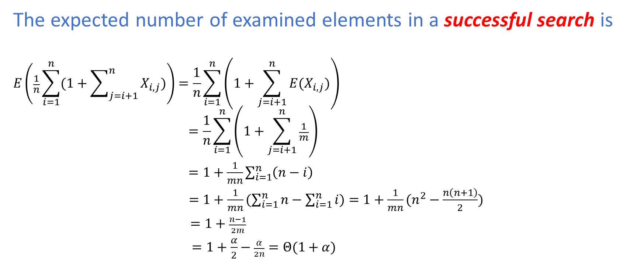
Successful Search
The expected number of examined elements in a successful search is
$$E\left(\frac{1}{n}\sum_{i=1}^{n}{(1+\sum_{j=i+1}^{n}{X_{i,j}})}\right)=\frac{1}{n}\sum_{i=1}^{n}{\left(1+\sum_{j=i+1}^{n}{E(X_{i,j})}\right)}$$
$$=\frac{1}{n}\sum_{i=1}^{n}{\left(1+\sum_{j=i+1}^{n}{\frac{1}{m}}\right)}$$
$=1+\frac{1}{mn}\sum_{i=1}^{n}{\left(n−i\right)}$
$=1+\frac{1}{mn}(\sum_{i=1}^{n}{n}−\sum_{i=1}^{n}{i)}=1+\frac{1}{mn}(n^{2}−\frac{n\left(n+1\right)}{2})$
$=1+\frac{n−1}{2m}$
$=1+\frac{α}{2}−\frac{α}{2n}=Θ(1+α)$

Slide 27
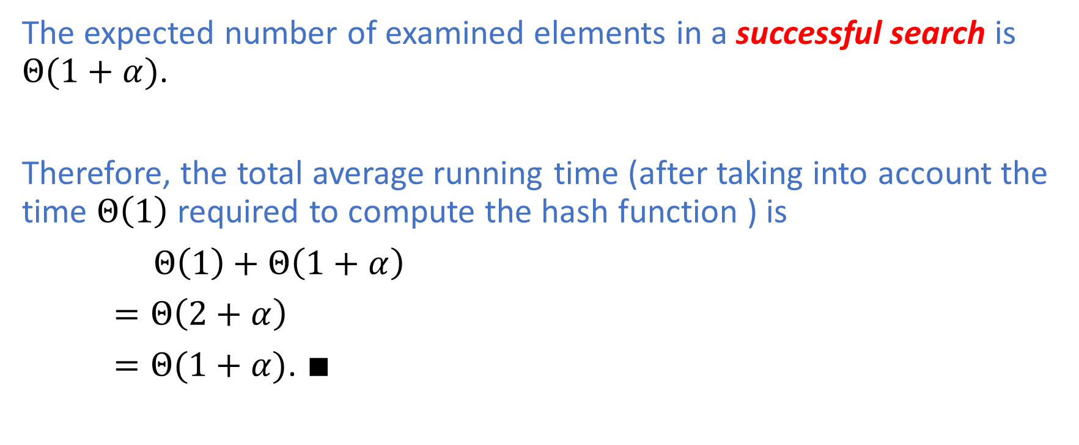
Successful Search
The expected number of examined elements in a successful search is $Θ(1+α)$.
Therefore, the total average running time (after taking into account the time $Θ\left(1\right)$ required to compute the hash function ) is
$Θ\left(1\right)+Θ\left(1+α\right)$
$=Θ\left(2+α\right)$
$=Θ(1+α)$. $∎$

Slide 28

Constant-Time Operations
If the load factor α is bound by some constant,
all the three basic operations run in $O(1)$ time
Search
Insert
Delete

Slide 29
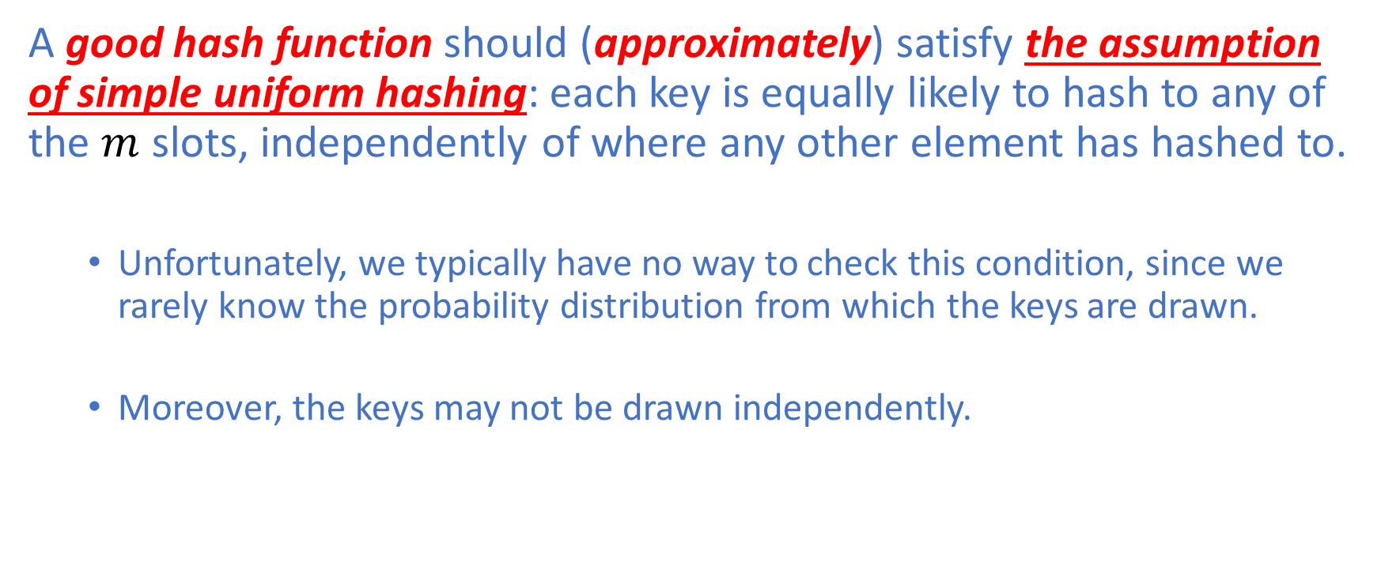
Hash Function
A good hash function should (approximately) satisfy the assumption of simple uniform hashing: each key is equally likely to hash to any of the $m$ slots, independently of where any other element has hashed to.
Unfortunately, we typically have no way to check this condition, since we rarely know the probability distribution from which the keys are drawn.
Moreover, the keys may not be drawn independently.

Slide 30
Heuristically Good Hash Functions
In practice, we can often employ heuristics to create a hash function that performs well.
We will discuss two variants of heuristics for creating good hash functions:
Division Method
Multiplication Method

Slide 31
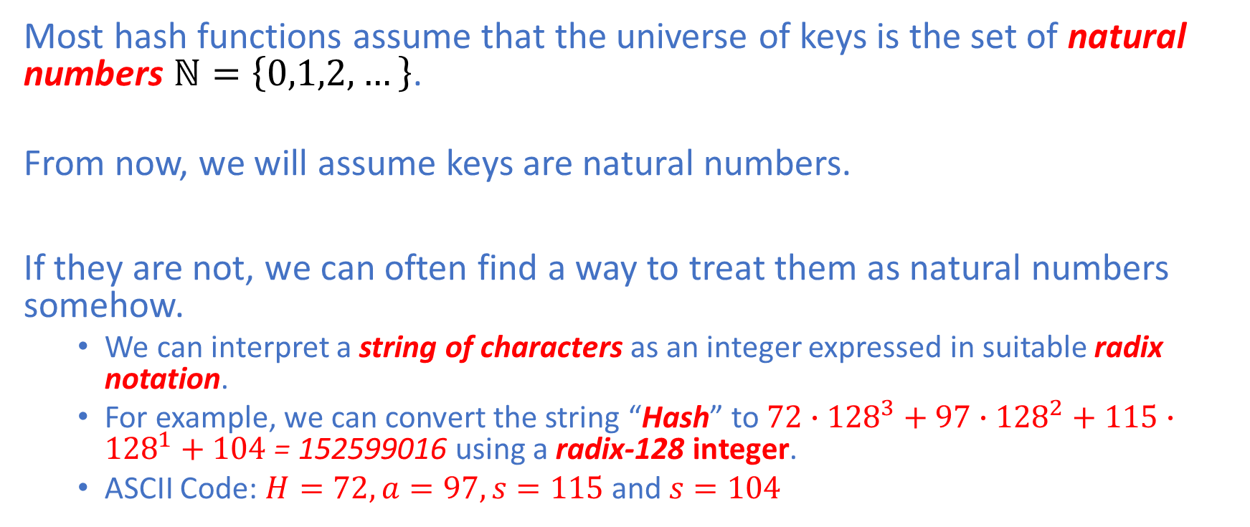
Interpreting keys as natural numbers
Most hash functions assume that the universe of keys is the set of natural numbers $ℕ=\left\{0,1,2,…\right\}$.
From now, we will assume keys are natural numbers.
If they are not, we can often find a way to treat them as natural numbers somehow.
We can interpret a string of characters as an integer expressed in suitable radix notation.
For example, we can convert the string “Hash” to $72∙{128}^{3}+97∙{128}^{2}+115∙{128}^{1}+104$ = 152599016 using a radix-128 integer.
ASCII Code: $H=72, a=97, s=115$ and $s=104$

Slide 32
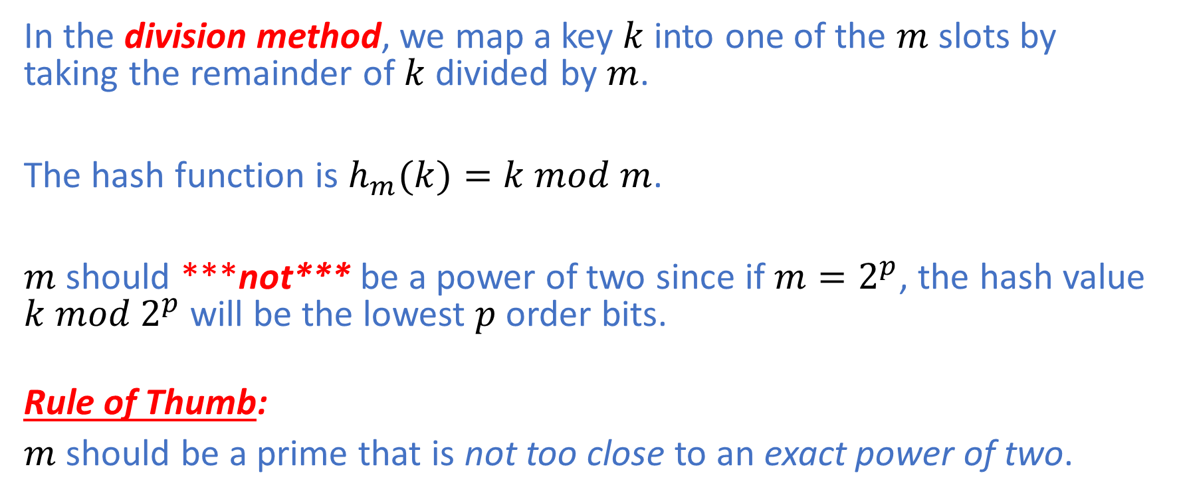
Division Method
In the division method, we map a key $k$ into one of the $m$ slots by taking the remainder of $k$ divided by $m$.
The hash function is $h_{m}(k)=k mod m$.
$m$ should ***not*** be a power of two since if $m=2^{p}$, the hash value $k mod{ 2}^{p}$will be the lowest $p$ order bits.
Rule of Thumb:
$m$ should be a prime that is not too close to an exact power of two.

Slide 33
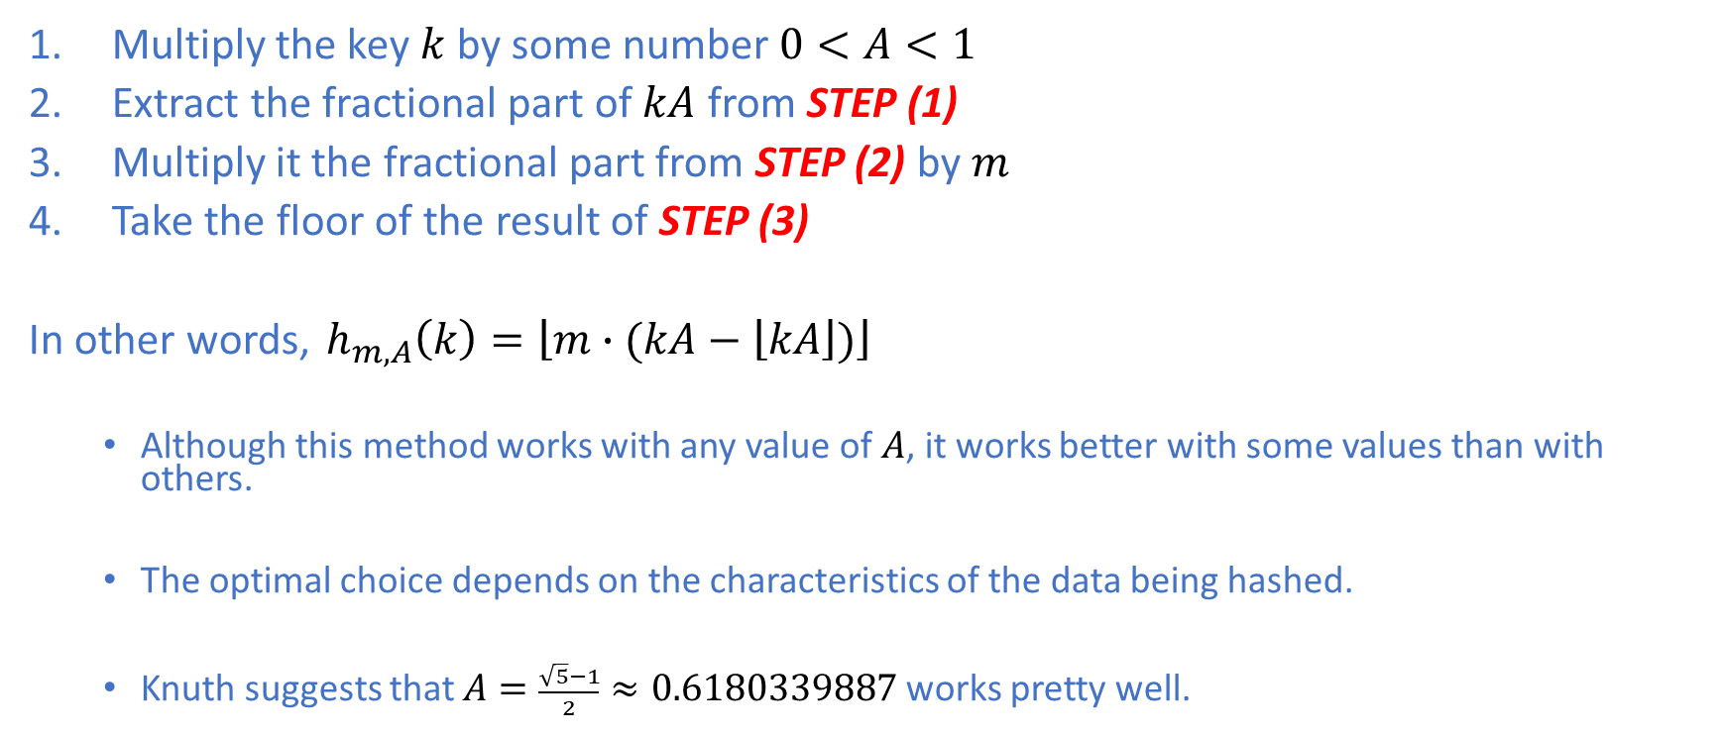
Multiplication Method
Multiply the key $k$ by some number $0<A<1$
Extract the fractional part of $kA$ from STEP (1)
Multiply it the fractional part from STEP (2) by $m$
Take the floor of the result of STEP (3)
In other words, $h_{m,A}\left(k\right)=\left\lfloor m∙(kA−\left\lfloor kA\right\rfloor )\right\rfloor$
Although this method works with any value of $A$, it works better with some values than with others.
The optimal choice depends on the characteristics of the data being hashed.
Knuth suggests that $A=\frac{\sqrt{5}−1}{2}≈0.6180339887$ works pretty well.

Slide 34
Open Addressing
In open addressing,
each slot stores at most one element, that is, each table slot either contains an element or is empty.
With the notion of probing,
each key does not need to always get mapped to a single slot.
in a collision, we perform collision resolution by successively examining in a systematic way the hash table until we eventually find an empty slot, into which the new element is inserted.
such a systematic way of examining the hash table is called probing.

Slide 35
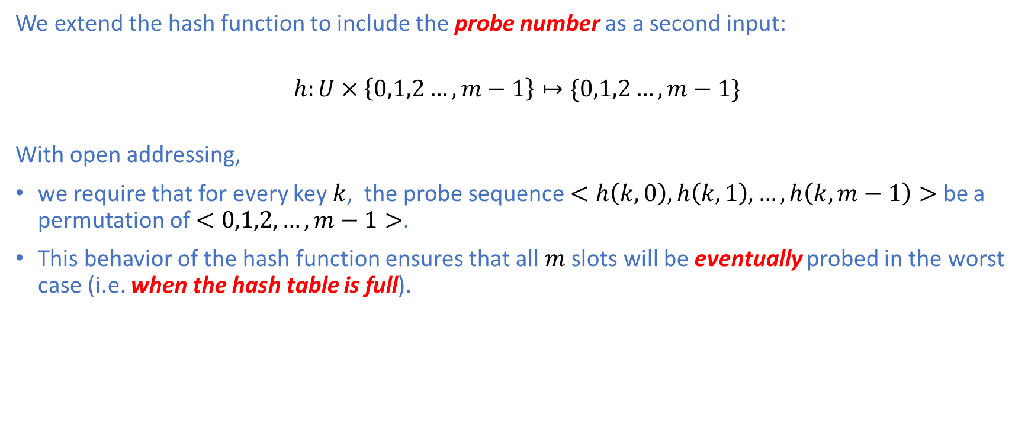
Probe Sequence
We extend the hash function to include the probe number as a second input:
$$h:U×\left\{0,1,2…,m−1\right\}↦\{0,1,2…,m−1\}$$ With open addressing,
we require that for every key $k$, the probe sequence $<h\left(k,0\right),h\left(k,1\right),…,h\left(k,m−1\right)>$ be a permutation of $<0,1,2,…,m−1>$.
This behavior of the hash function ensures that all $m$slots will be eventually probed in the worst case (i.e. when the hash table is full).

Slide 36
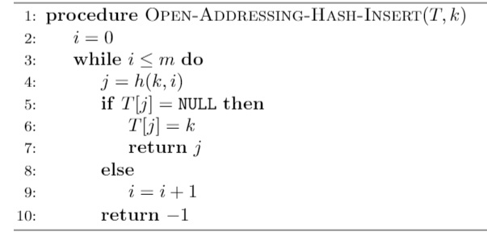
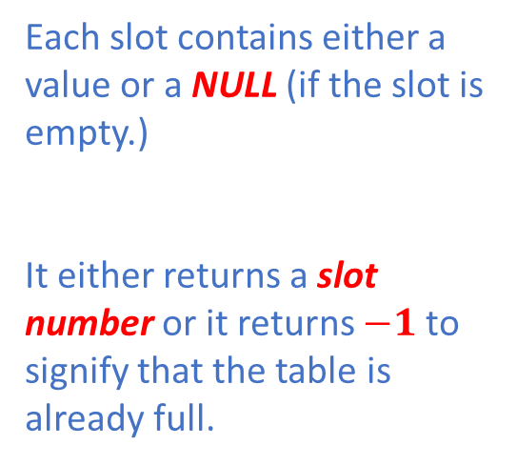
Basic Operation: Insert
For the purpose of simplicity,
we assume that keys $k_{i}$ and elements $x_{i}$have the same value, i.e., $k_{i}=x_{i}.key$.
Each slot contains either a value or a NULL (if the slot is empty.)
It either returns a slot number or it returns $−1$ to signify that the table is already full.

Slide 37
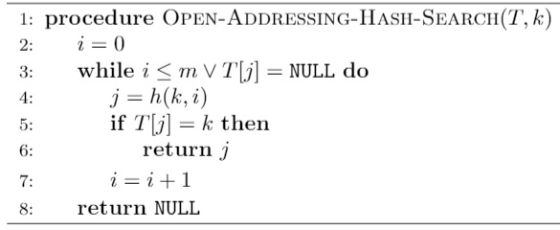
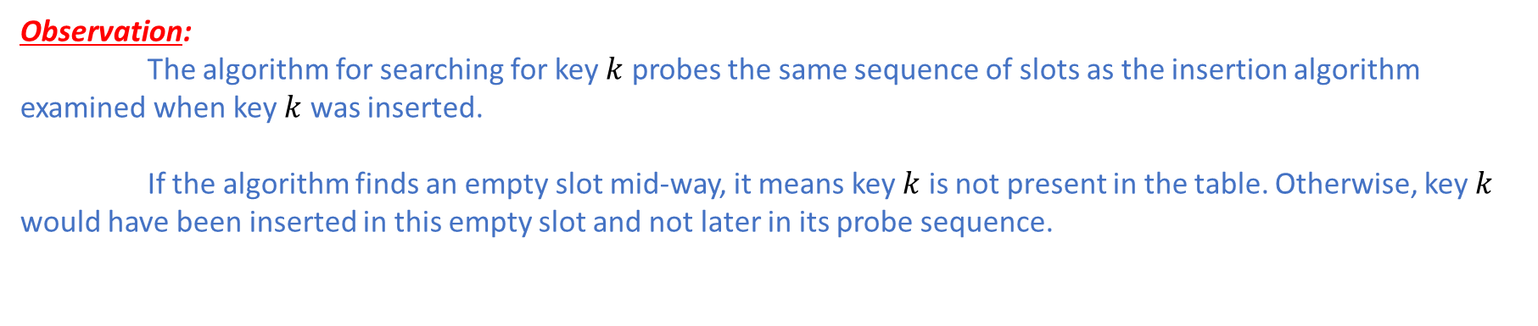
Basic Operation: Search
Successful Search:
The search will return the element being searched for if the element is stored in the hash table.
Unsuccessful Search:
There are two possibilities for an unsuccessful search:
an empty slot is encountered
the end of the hash table is reached
Observation:
The algorithm for searching for key $k$ probes the same sequence of slots as the insertion algorithm examined when key $k$ was inserted.
If the algorithm finds an empty slot mid-way, it means key $k$ is not present in the table. Otherwise, key $k$ would have been inserted in this empty slot and not later in its probe sequence.

Slide 38
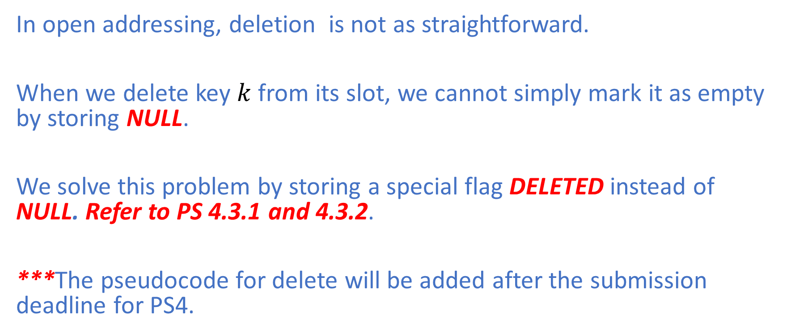
Basic Operation: Deletion
In open addressing, deletion is not as straightforward.
When we delete key $k$ from its slot, we cannot simply mark it as empty by storing NULL.
We solve this problem by storing a special flag DELETED instead of NULL. Refer to PS 4.3.1 and 4.3.2.
***The pseudocode for delete will be added after the submission deadline for PS4.

Slide 39
Probing Techniques
We will show three probing techniques that can be used to produce probe sequences:
Linear Probing
Quadratic Probing
Double Hashing

Slide 40
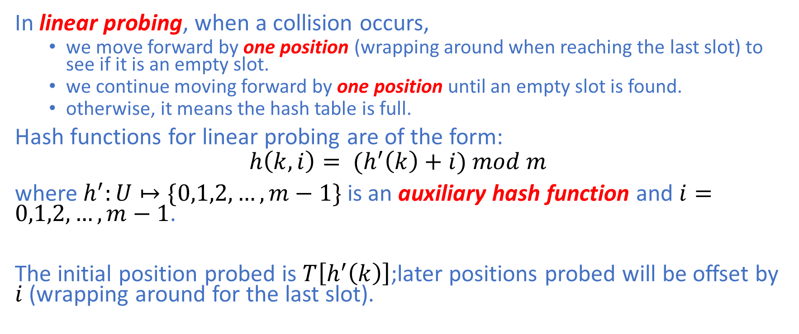
Linear Probing
In linear probing, when a collision occurs,
we move forward by one position (wrapping around when reaching the last slot) to see if it is an empty slot.
we continue moving forward by one position until an empty slot is found.
otherwise, it means the hash table is full.
Hash functions for linear probing are of the form:
$$h\left(k,i\right)= {(h}^{′}\left(k\right)+i) mod m$$
where $h^{′}:U↦\{0,1,2,…,m−1\}$ is an auxiliary hash function and $i=0,1,2,…,m−1$.
The initial position probed is $T\left[h^{′}\left(k\right)\right]$;later positions probed will be offset by $i$ (wrapping around for the last slot).

Slide 41
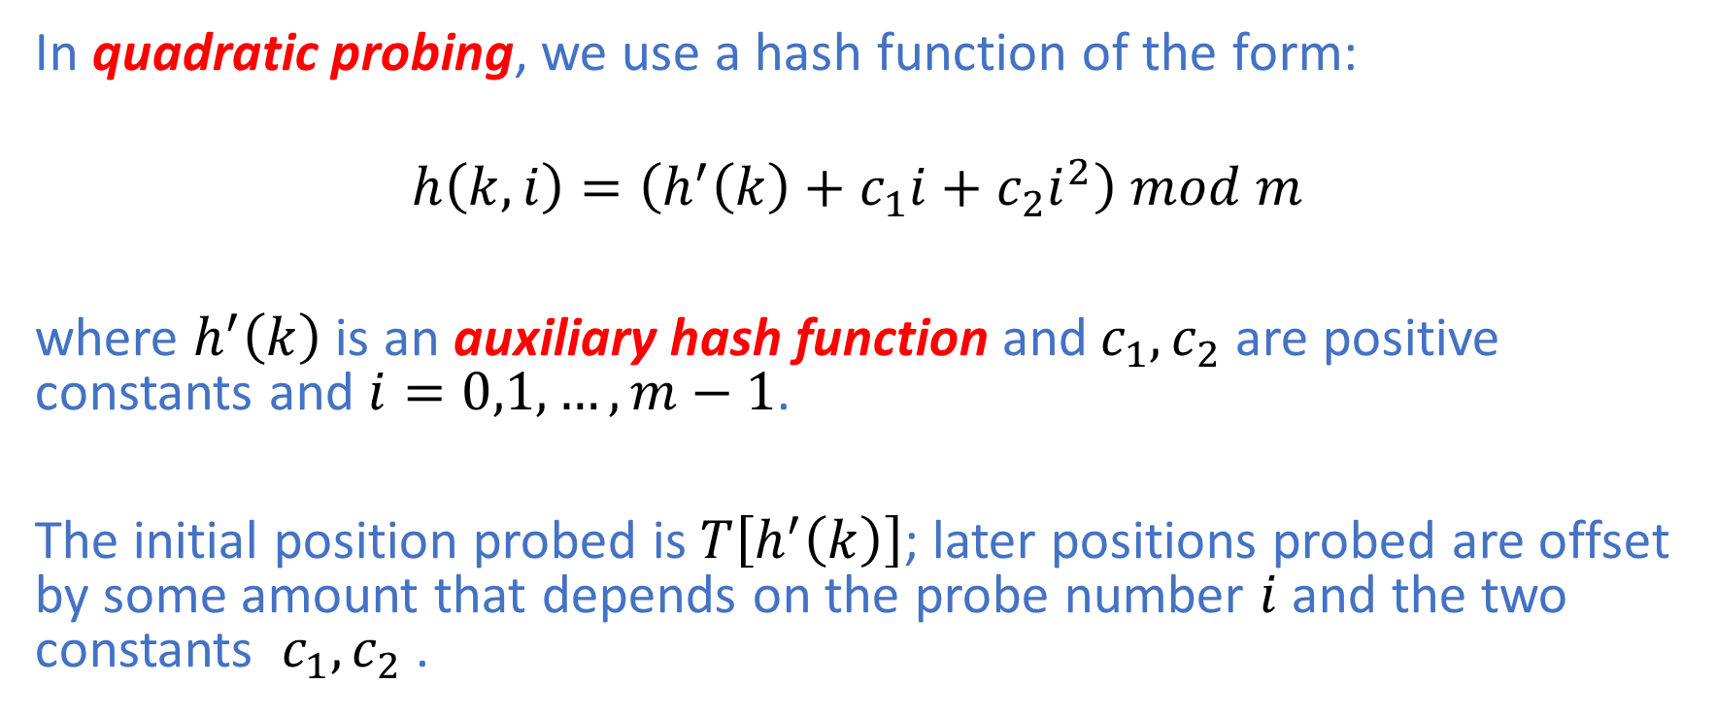
Quadratic Probing
In quadratic probing, we use a hash function of the form:
$$h\left(k,i\right)=\left(h^{′}\left(k\right)+c_{1}i+c_{2}i^{2}\right) mod m$$
where $h^{′}\left(k\right)$ is an auxiliary hash function and${ c}_{1},c_{2}$ are positive constants and $i=0,1,…,m−1$.
The initial position probed is $T\left[h^{′}\left(k\right)\right]$; later positions probed are offset by some amount that depends on the probe number $i$ and the two constants ${ c}_{1},c_{2}$ .

Slide 42
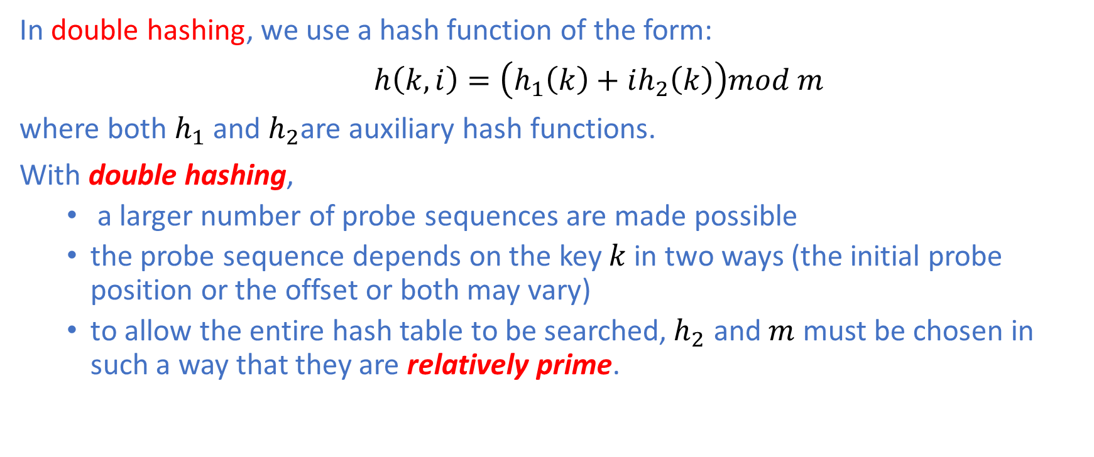
Double Hashing
In double hashing, we use a hash function of the form:
$h\left(k,i\right)=\left(h_{1}\left(k\right)+ih_{2}\left(k\right)\right)mod m$
where both $h_{1}$ and $h_{2}$are auxiliary hash functions.
With double hashing,
a larger number of probe sequences are made possible
the probe sequence depends on the key $k$ in two ways (the initial probe position or the offset or both may vary)
to allow the entire hash table to be searched,${ h}_{2}$ and $m$ must be chosen in such a way that they are relatively prime.
Double hashing makes probe sequences look more random than linear and quadratic probing so it performs better.

Slide 43
Summary
We have learned the following topics:
Direct-Address Table
Hash Table
Collision Resolution
Separate Chain Method
Open Address Method
Next time, we will cover sorting algorithms.

